Slide 1
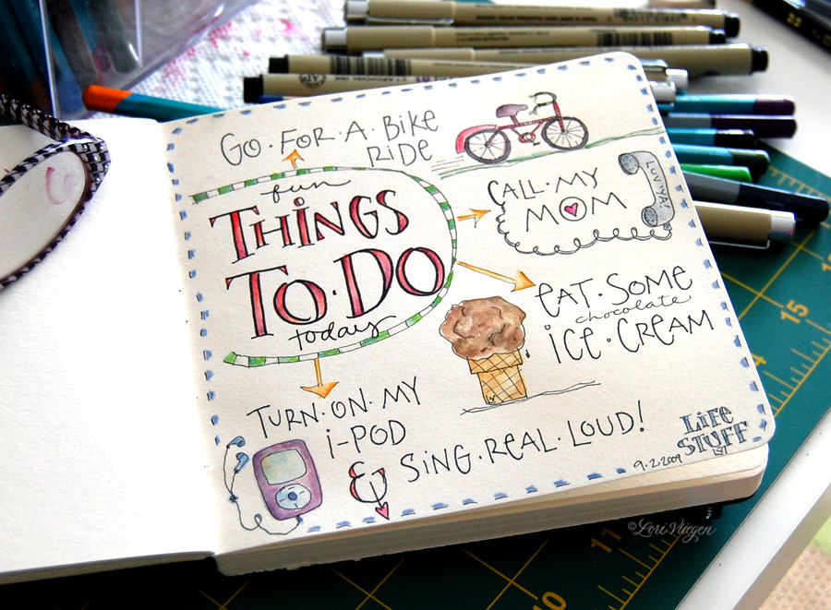
TO DO LISTS (WEB-APP)
BY
SAURABH KOLHE
RUTUJA POTE
DHARA BHAVSAR
SHAHNAWAZ BISWAS

Slide 2
INTRODUCTION
INTRODUCTION Our -- app is designed out to be the most interactive unlike the digital versions of to do list. We aim our users to be more productive and punctual in their tasks and to create a motivating enviornment our app has special features that compliments them.

Slide 3
FUNCTIONAL SPECIFICATIONS
The user will first have to login with his email and an unique password. Upon login, the user can add a list of tasks for the day with the deadlines. 5 minutes prior to the specified deadline, the user will receive an ALERT!

Slide 4
TECHNOLOGIES AND LIBRARIES
React.js: A declarative, efficient, and flexible JavaScript library for building user interfaces.
Create-react-app: Create React apps with no build configuration.
React-Router: Declarative routing for React.
Bootstrap: The most popular HTML, CSS, and JavaScript framework for developing responsive, mobile first projects on the web.
Live Server:Live, web-based browser testing. Font awesome: The iconic font and CSS toolkit.
JWT : Authentication of user login credentials

Slide 5
DATABASE BACKEND
The app leverages MongoDB to create and store user credentials .i.e email as login ID and password

Slide 6
FUTURE SCOPE
Reward system can be created for user upon completing all the tasks for seven days in a row. Rewards will encompass the vouchers, coupons, etc. There can also be dashboard where family and friends can track each other’s activities . Parents can also reward their children on completions of the task they have assigned. This will promote the productivity among the family and friends.

